Slide 1
Technique of Intra-uterine Therapy

Slide 2
OBJECTIVE:
To introduce the drugs into the uterus to overcome the infection in various disease conditions.
MATERIALS REQUIRED:
Obel's apparatus, catheter, syringe, cotton, saline, pipettes, etc.

Slide 3
PROCEDURE
1.Clean vulva and perineal region with the dry cotton.
2.Insert the left hand in the rectum and remove the faecal material by back racking.
3.Spread vulva apart and insert the instrument (catheter or Obel's apparatus) up to fornix.
4.Hold the cervix between two fingers through rectal wall and keep thumb on the external os.

Slide 4
5.The catheter is initially inserted pointing upwards at an angle of about 30° to avoid entering into the external urethral opening
and is then moved horizontally until it is engaged in the external “os” of the cervix.

Slide 5
6.Entry into the external os is accompanied by a characteristic "gritty' sensation. Thereafter, introduce the catheter through convoluted cervical canal by manipulation of the cervix through rectal wall.
7.Place one finger over the internal os of the cervix, so that the tip

Slide 6
IMPORTANT POINTS
The recto-vaginal method of intrauterine medication requires
considerable practice for success.
Obstruction in passing catheter by vaginal folds can be minimized
by pushing the cervix forward. By doing this, vaginal passage
becomes unfolded.
After passing catheter in the cervix, no forward pressure should
be exerted on the catheter with the right hand because uterine
wall is friable and easily penetrated if the catheter moves
suddenly.

Slide 7
The most common fault during intra uterine therapy is twisting
of cervix in the left hand which occludes uterine horns.
INTERESTING FACTS
The irritant solutions or antibiotics, such as Lugol's iodine , tetracycline, etc., when given intrauterine, affects the length of estrous cycle.

Slide 8
The irritant intrauterine infusions given during days 3 to 9 of
the cycle (estrus day 0) may significantly shorten the time forthe female to return in oestrus.
The infusions at estrus or mid-diestrus does not affect oestrous
cycle length.
The infusions on days 14 to 17 of the cycle (estrus day 0) prolong
the luteal period or estrous cycle length.

Slide 9
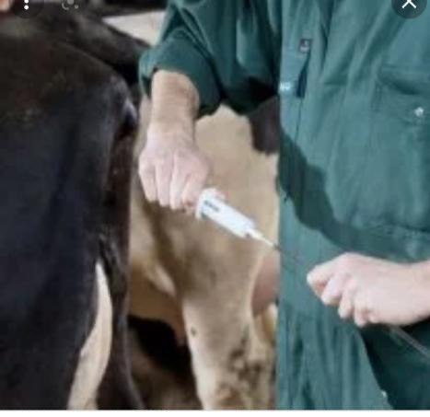

Slide 10
Measures of reproductive performance

Slide 11
Fertility
the ability of male and female animals to produce viable germ
cells, mate, conceive and deliver normal living young The lifetime
productivity of a cow is influenced by age at puberty
.

Slide 12
1.age at first calving
First calving marks the beginning of a cow's productive life . Age at first calving is closely related to generation interval and, therefore, influences response to selection.
Under controlled breeding, heifers are usually mated when they are mature enough to withstand the stress of parturition and lactation.

Slide 13
2-Fertility (calving) rates
Fertility in cattle is affected by environmental, genetic, disease and management factors. These influence the reproductive process at ovulation, fertilization or implantation or during gestation and parturition.
The commonest estimate of fertility rate is the percentage of mated or inseminated cows that become pregnant (pregnancy rate) or finally calve
(calving rate).

Slide 14
a- Effects of age and lactation
found that fertility rate increased from 69% in 2.5-year-old cows to a maximum of 82% in 6- to 7 year-old cows and then declined. also recorded an increase in pregnancy rate from 50% in 3-year-old to 75% in 7-year-olds. Fertility then declined to 50% among 12-year-olds.

Slide 15
Causes of these age-related differences include locational stress in young growing animals and the ability of older cows to gain bodyweight and condition quickly after calving.

Slide 16
b- Effect of breed
c- Effect of bodyweight
d- Effects of year and season
e- Genetic effects

Slide 17
3 Number of services per conception
The number of services per conception (NSC) depends largely on the breeding system used. It is higher under uncontrolled natural breeding
and low where hand-mating or artificial insemination is used.

Slide 18
4 .Calving interval
Calving interval can be divided into three periods: gestation, postpartum
anestrus (from calving to first estrus) and the service period (first
postpartum estrus to conception). This is sometimes also called the
"days open", period and is the part of the calving interval that can be
shortened by improved herd management.

Slide 19
The “days open”
period should not exceed 80-85 days if a calving interval
of 12 months is to be achieved . This requires re-establishment of ovarian activity soon after calving and high conception rates. The duration of this
period is influenced by nutrition, season, milk yield, parity, suckling and
uterine involution. At any time, the effects of one or more of these factors may be confounded.

